Slide 1
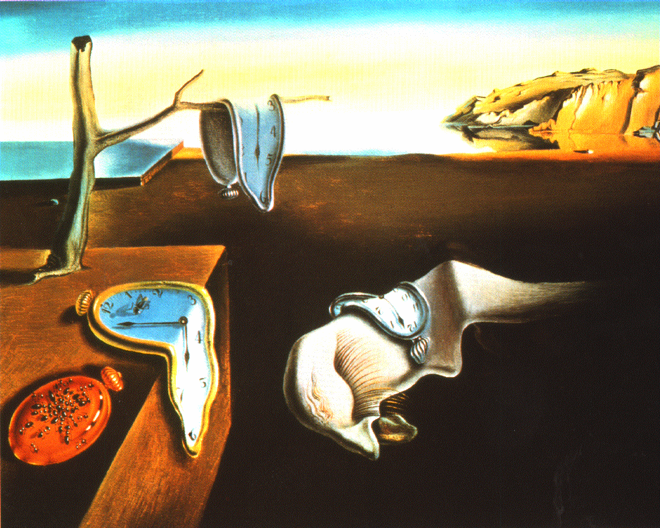
Mechanisms and Counter Mechanisms

Slide 2
Charter 2011
5.4 When suggesting parameters to the debate, or proposing particular models or criteria to judge it by, the Proposition must ensure such parameters, models or criteria are themselves reasonable. They must be ones that the ordinary intelligent person would accept as applicable to the debate.
5.4.1 The Proposition‘s ability to set reasonable parameters to a debate does not provide a licence to restrict the motion arbitrarily.
5.4.2 When the motion requires the Proposition to propose a solution to a problem and the Proposition has to set out the details of its proposed solution to prove its effectiveness, the Proposition must ensure that the detailed solution given (the Proposition‘s ‗model‘ or ‗plan‘) is a reasonable one, such that the ordinary intelligent person would accept it is applicable to the debate.

Slide 3
WSDC Notes the Adjudicator by Christopher Erskine
7.4 In responding to the proposition case, the opposition team may produce a positive choice of its own, or merely attack the case presented by the proposition. If it chooses to produce a positive case of its own, it must in fact produce that case through its speeches, and not concentrate solely on attacking the case presented by the proposition.
Notes:
Theory Discussion: How is a counter-mechanism or a counter-plan an attack of the propositions case?

Slide 4
Opposition Strategies
Counterproposals:
Must be mutually exclusive
If it is equally as good it is not a reason to reject the proposal; must be net beneficial
Notes:
Theory Discussion:
Why must a counter-mechanism be mutually exclusive?
How can the proposition win even if their counter mechanism is not mutually exclusive?

Slide 5
When to use a mechanism
Some say mechanisms are usually warranted when the motion says THW and criteria is warranted when THB but…
This House believes that political parties should receive state funding
This House would use affirmative action in response to historical injustice
This House believes that education policy should be the responsibility of local authorities
This House would negotiate with terrorists
This House believes that African problems require African solutions.
Notes:
REMEMBER: Everything is DEBATEABLE!
Do these motions warrant a mechanism?
Even if you think that they don’t could you put a mechanism to them?
Why would you want to apply a mechanism in these debates?

Slide 6
What goes into a Mechanism?
Agent of Action
Funding
MECHANISM
Mandates
Enforcement

Slide 7
Agent of Action
“define who is to operate the Affirmative plan…In many cases, the Affirmative is content to rely on a status quo agency…”Plan:Introduction to Policy Debate 2002 John R. Prager http://webpages.charter.net/johnprager/IPD/Chapter03.htm
Notes:
The first elipses is due to the passage being very US centric or focused on just one country
The last part is just ridiculous in WSDC debate

Slide 8
Mandates
“are the basic provisions of what the plan should accomplish….They are the reforms that the Affirmative team is proposing; they are the actions that will put the Affirmative resolution into effect.”
Plan:Introduction to Policy Debate 2002 John R. Prager http://webpages.charter.net/johnprager/IPD/Chapter03.htm
Notes:
So what are the parts of a mechanism?
How do you know when you have a good solid mechanism?
This part is not Rocket Science…like that’s hard…

Slide 9
Enforcement provisions
“… the penalty…for violating any laws proposed by the Affirmative’s mandates; these planks may also specify what agencies will prosecute cases…”
Plan:Introduction to Policy Debate 2002 John R. Prager http://webpages.charter.net/johnprager/IPD/Chapter03.htm

Slide 10
Funding$
“Not all plans need funding, but most need some source of money to put the mandates into effect.”
Plan:Introduction to Policy Debate 2002 John R. Prager http://webpages.charter.net/johnprager/IPD/Chapter03.htm
Notes:
This could be BIG on the Africa topic.

Slide 11
How about this mechanism?
THAT DOCTORS SHOULD REPORT EVIDENCE OF MARITAL ABUSE TO THE POLICE
Mechanism:
Dr.’s would report suspected abuse to the police
Prosecution would follow normal means
Convicted abusers would be given a choice of jail time or rehabilitation.
Normal means would be used for enforcement and funding (Nothing new is needed but the law)
Notes:
EXTRA TOPICALITY! (This is a good exercise just to get them thinking about what are the limits of the mechanism on prop and the opp?)
Is there anything wrong with this mechanism?
We had good evidence saying that they almost always chose rehab and that rehab was incredibly effective!
Why should the proposition get to advocate what happens with procedures in courts of law when the motion only asks for a defense of the doctors actions?
If you would allow that, then why couldn’t the proposition just fiat that all the abusers just stop abusing their wives?

Slide 12
Counter Mechanism Theory:
Same as the mechanism: Requirement 1
Mandates
Agency
Enforcement
Funding

Slide 13
Requirement 2: Non-Topical
THW require welfare recipients to pass a drug test.
Proposition Mechanism
All recipients of welfare or public assistance will be subject to monthly drug testing in order to receive their benefits.
Opposition Counter Mechanism
Only recipients with a past drug history would be tested to receive public assistance.
Should not be representative of the motion or else it grants the Proposition the debate.
Notes:
What is the difference between Should and Would?
Should vs ought will lead to a definitional debate

Slide 14
Requirement 3: Mutually Exclusive
The Counter Mechanism is a test of opportunity cost, otherwise it is NOT an attack on the Proposition.
THW ban affirmative action.
The model is to phase out affirmative action in all universities and job placement.
The Counter-Mechanism would use only economically based affirmative action policies. They have big advantages!
Permutation Theory!
Can do the plan and counter plan at the same time? If so, is it a test of opportunity cost.
BUT you must also pass one more test!
Notes:
If the opposition only has the burden of clashing with the propositions case then why should they get to bring in things that are outside the topic such as a non topical counter-mechanism.
How could the proposition be prepared for all the things that the opposition could do outside the topic. They could dismantle all nuclear weapons instead of worrying about whether or not to report abusive husbands to the police. This would certainly win them the debate round if the only limit was that they had to be non-topical. Therefore mutual exclusivity is one of the tests that the counter mechanism must meet to beat the Prop mechanism.

Slide 15
AND/OR Net Beneficial
C/Mechanism > Mechanism
If not, then maybe there is an opportunity cost but not better than the one we have
C/Mechanism > Mechanism + C/M
If the permutation is feasible, then the counter mechanism must be able to still outweigh the mechanism and the counter mechanism together!
Notes:
See the next slide for an example

Slide 16
THBT THAT WE SHOULD SUPPORT MILITARY INTERVENTION IN SOMALIA
Mechanism was to bring NATO Forces into Somalia to bolster the two countries that had African Union peacekeepers so they could overcome Al Shabab
Counter Mechanism was
To give jobs to the jihad fighters who wanted jobs (Good ev they wanted them)
Allow govt forces to fight their own fight against Al Shabab (good ev against Western forces, good ev that the government had been bolstered by Somali forces trained in Kenya)
Notes:
Does this counter mechanism pass the test?
Is it mutually exclusive/ permutable?
Is it net beneficial?

